Slide 1
Chapter 5: Dynamic Analysis-Test Design Techniques
Software Testing
Path Coverage and Condition Coverage Testing

Slide 2
Flow Graph Notation
A circle in a graph represents a node
- Sequence of one or more statements
A node containing a simple conditional expression is referred to as a predicate node
- A predicate node has two edges leading out from it (True and False)
An edge, or a link, is an arrow representing flow of control in a specific direction
- An edge must start and terminate at a node
- An edge does not intersect or cross over another edge
Areas bounded by a set of edges and nodes are called regions

Slide 3
Cyclomatic Complexity
Cyclomatic Complexity for a flow graph is computed in one of three ways:
Cyclomatic complexity, V(G), for a flow graph G is defined as V(G) = E – N + 2
Cyclomatic complexity, V(G), for a graph flow G is also defined as V(G) = P + 1 (P is the number of predicate nodes).
The number of regions of the flow graph correspond to the cyclomatic complexity.
V(G) = Number of regions of flow graph

Slide 4
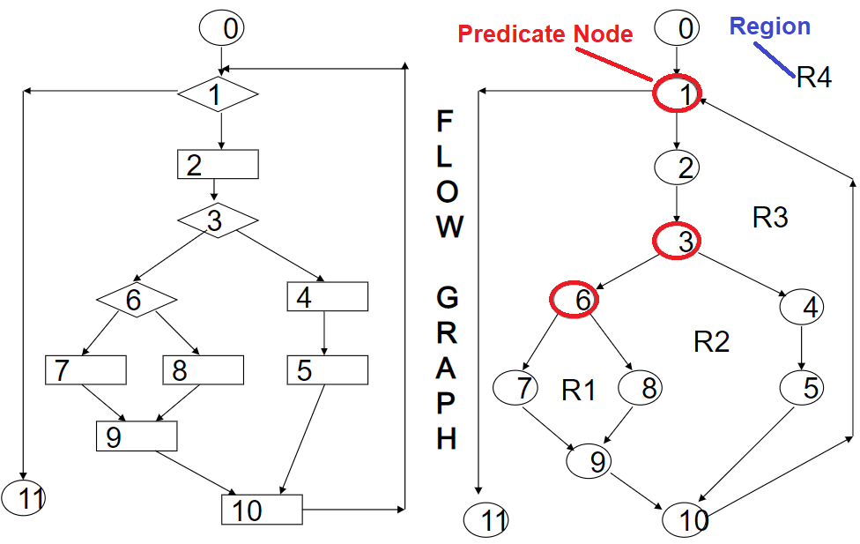
Flow Graph Notation
Here R1,R2, R3 and R4 are the regions
Nodes 1, 3 and 6 are the predicate nodes

Slide 5
Path Coverage Testing
White box testing technique
Ensures covering of all the paths of a program are traversed atleast once.
It’s more powerful than branch coverage.
All possible control paths taken, including all loop paths taken zero, once, and multiple (ideally, maximum) items in path coverage technique
The test cases are prepared based on the logical complexity measure of a procedural design.

Slide 6
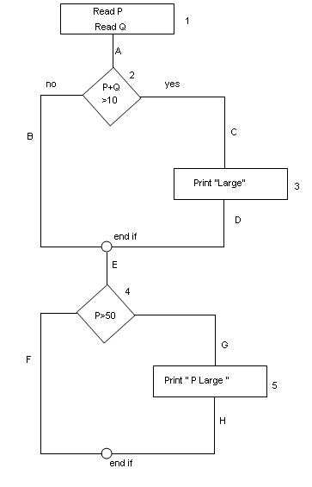
Path Coverage Testing Example
Read P
Read Q
IF P+Q > 100 THEN
Print “Large”
ENDIF
If P > 50 THEN
Print “P Large”
ENDIF

Slide 7
Path Coverage Testing Example
Statement Coverage: 1
1A-2C-3D-E-4G-5H
Decision Coverage: 2
1A-2C-3D-E-4G-5H ,
1A-2B-E-4F
Path Coverage: 4
1A-2B-E-4F
1A-2B-E-4G-5H
1A-2C-3D-E-4G-5H
1A-2C-3D-E-4F

Slide 8
Path Coverage Testing Example
Let us say your test case covers the
following route - 1A -> 2B -> E -> 4F
There are total of 4 Paths in your flowchart
You cover only 1 Path
Calculate the Path Coverage - (1/4)*100
Your Test Case, therefore, has 25% of Path Coverage

Slide 9
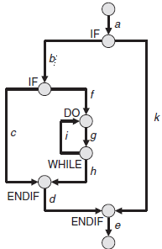
Statement and Decision Example (With Loop)
For 100% statement coverage, a test case executing the following order of edges was sufficient:
a, b, f, g, h, d, e
The edges c, i, and k have not been executed in this test case. The edges c and k are empty
branches of a condition, while the edge i is the return to the beginning of the loop.
Three test cases are necessary for complete coverage of edges:
TC#1: a, b, c, d, e
TC#2: a, b, f, g, i, g, h, d, e
TC#3: a, k, e
All three test cases result in complete coverage of the edges of the control flow graph. With that, all possible branches of
the control flow in the source code of the test object have been tested.

Slide 10
Path coverage Example(With Loop)
For 100% statement coverage, a test case executing the following order of edges was sufficient:
a, b, f, g, h, d, e
In the WHILE condition at the end of the loop, it is decided whether the loop must be repeated, that is, if a jump back to the start of the loop is necessary. When using branch coverage for test design, the loop has been considered in two test cases:
Loop without repetition:
a, b, f, g, h, d, e
Loop with single return (i) and a single repetition:
a, b, f, g, i, g, h, d, e
Usually a loop is repeated more than once. Further possible sequences of branches through the graph of the program are as follows:
a, b, f, g, i, g, i, g, h, d, e
a, b, f, g, i, g, i, g, i, g, h, d, e
a, b, f, g, i, g, i, g, i, g, i, g, h, d, e
etc.
This shows that there are an indefinite number of paths in the control flow graph. Even with restrictions on the number of loop repetitions, the number of paths increases indefinitely

Slide 11
Conditional Testing and Coverage
Branch coverage exclusively considers the logical value of the result of a condition (“true” or “false”).
Using this value, it is decided which branch in the control flow graph to choose and, accordingly, which statement is executed next in the program.
If a decision is based on several (partial) conditions connected by logical operators, then the complexity of the condition should be considered in the test.
The goal of condition testing is to cause each atomic (partial) condition in the test to adopt both a true and a false value.
An atomic partial condition is a condition that has no logical operators such as AND, OR, and NOT but at the most includes relation symbols such as > and =. A condition in the source code of the test object can consist of multiple atomic partial conditions.

Slide 12
Conditional Testing and Coverage Example
An example for a combined condition is (x > 3 OR y < 5). The condition consists of two conditions (x > 3; y < 5) connected by the logical operator OR.
The goal of condition testing is that each partial condition (i.e., each individual part of a combined condition) is evaluated once, resulting in each of the logical values.
The test data x = 6 and y = 8 result in the logical value true for the first condition (x > 3) and the logical value false for the second condition (y < 5). The logical value of the complete condition is true (true OR false = true).
The second pair of test data with the values x = 2 and y = 3 results in false for the first condition and true for the second condition.

Slide 13
Conditional Testing and Coverage Example
The value of the complete condition results in true again (false OR true = true). Both parts of the combined condition have each resulted in both logical values.
The result of the complete condition, however, is equal for both combinations.
Condition coverage is therefore a weaker criterion than statement or branch coverage

Slide 14
Multiple Condition Testing
It is a more comprehensive criterion that also takes into account the complexity of combined conditions.
But this is a very expensive technique due to the growing number of atomic partial conditions that make the number of possible combinations grow exponentially (to 2n, with n being the number of atomic partial conditions).
Multiple condition testing requires that all true-false combinations of the atomic partial conditions be exercised at least once. All variations should be built, if possible.

Slide 15
Multiple Condition Testing
Four combinations of test cases are possible with the test data from the previous example for the two conditions (x > 3 OR y < 5):
x = 6 (T), y = 3 (T), x > 3 OR y < 5 (T)
x = 6 (T), y = 8 (F), x > 3 OR y < 5 (T)
x = 2 (F), y = 3 (T), x > 3 OR y < 5 (T)
x = 2 (F), y = 8 (F), x > 3 OR y < 5 (F)

Slide 16
Not all combinations are always possible
A problem results from the fact that test data cannot always generate all combinations.
An example should clarify this. For the combined condition of 3 ≤ x AND x<5 not all combinations with the according values for the variable x can be produced because the parts of the combined condition depend on each other:
x = 4: 3 ≤ x (T), x < 5 (T), 3 ≤ x AND x < 5 (T)
x = 8: 3 ≤ x (T), x < 5 (F), 3 ≤ x AND x < 5 (F)
x = 1: 3 ≤ x (F), x < 5 (T), 3 ≤ x AND x < 5 (F)
x = ?: 3 ≤ x (F), x < 5 (F), combination not possible because the value x shall be smaller than 3 and greater than or equal to 5 at the same time.

Slide 17
Example of Complete Condition Testing
Create a test case for all 2n T/F combinations of the simple sub expressions
If (!done && (value < 100 || c == 'X')) …
Simple sub-expressions
!done, value < 100, c == 'X’
n = 3
Need 8 test cases to test all possibilities

Slide 18
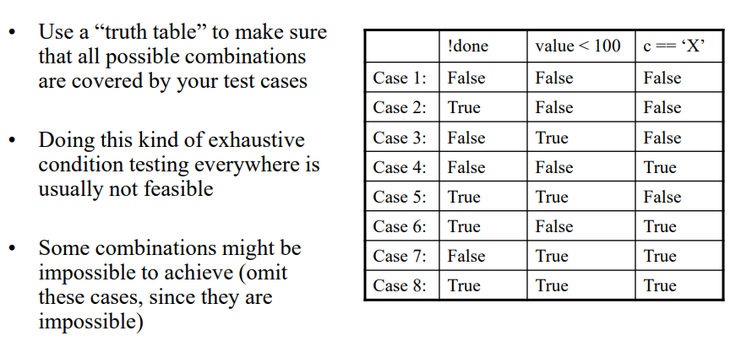
Complete Condition testing

Slide 19
Disadvantage of Condition testing
A disadvantage of condition testing is that it checks Boolean expressions only inside a statement (for example, IF statement). In the following example of a program fragment, the following fact remains undetected: the IF condition actually consists of multiple parts and condition determination testing needs to be applied.
Flag = (A || (B && C));
If (Flag)
...;
else ...;
Condition coverage is therefore a weaker criterion than statement or branch coverage

Slide 20
Thank you

